Slide 1

UNSUPERVISED LEARNING

Slide 2
UNSUPERVISED LEARNING
Unsupervised Learning refers to all kinds of machine learning where there is no known output no sort of "labels" that we are using to predict an outcome
Rather, the algorithm is given data and asked to extract knowledge based on any patterns it is able to find
Data Squad | Unsupervised Learning

Slide 3
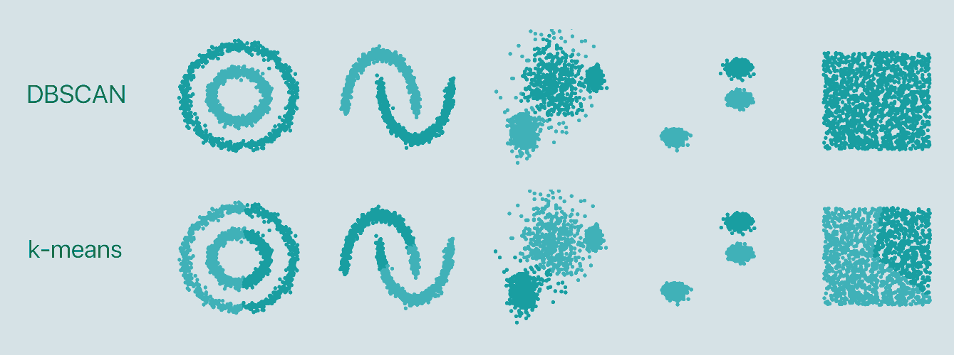
UNSUPERVISED LEARNING
Data Squad | Unsupervised Learning

Slide 4
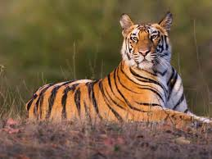

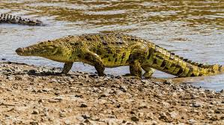

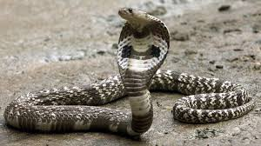

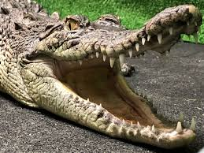
UNSUPERVISED LEARNING
Data Squad | Unsupervised Learning

Slide 5
UNSUPERVISED LEARNING
Data Squad | Unsupervised Learning

Slide 6
UNSUPERVISED LEARNING
Different clustering algorithms use different methods to define what is 'similar'
Data Squad | Unsupervised Learning

Slide 7
UNSUPERVISED LEARNING
Typical Usecases
- Topic Identification (when analysing emails, documents articles)
- Image Clustering
- Retail basket analysis
- Dimensionality Reduction
Data Squad | Unsupervised Learning

Slide 8
CLUSTERING TECHNIQUES
Clustering is the task of partitioning the dataset into groups of similarity called clusters
Clustering algorithms assign a number to each datapoint indicating which cluster it belongs to.
Data Squad | Unsupervised Learning

Slide 9
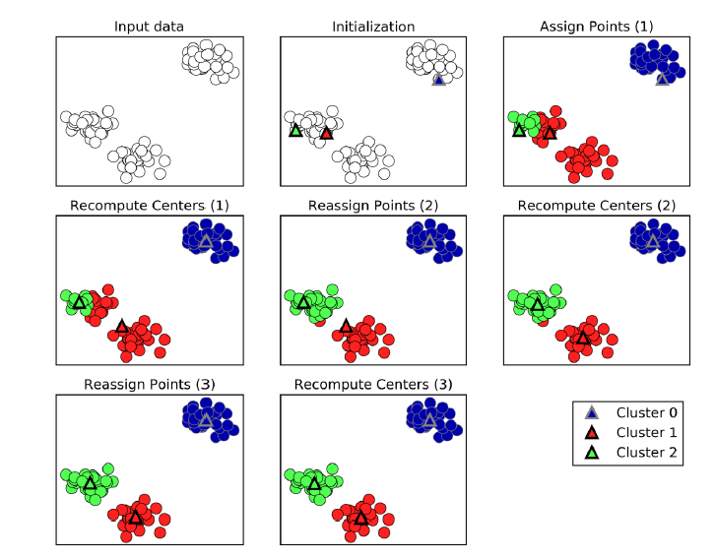
K-MEANS CLUSTERING
Data Squad | Unsupervised Learning

Slide 10
K-MEANS CLUSTERING
Data Squad | Unsupervised Learning

Slide 11
K-MEANS CLUSTERING
Data Squad | Unsupervised Learning

Slide 12
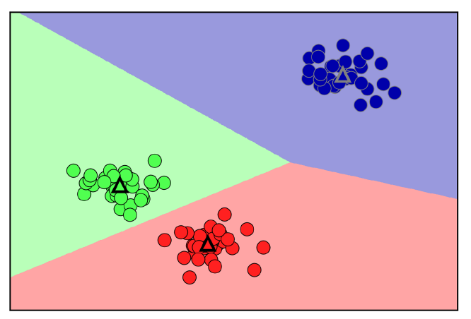
K-MEANS CLUSTERING
In the end you are left with areas that identify in which a cluster a newly assigned point would be classified.
These are known as the Voronoi Regions
Regions identify the closest centroid center to each point
Data Squad | Unsupervised Learning

Slide 13
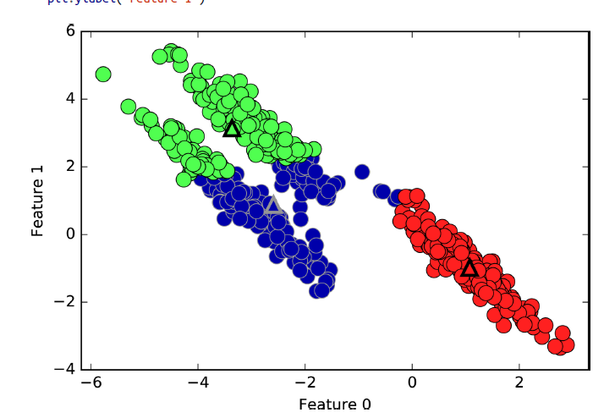
K-MEANS CLUSTERING - LIMITATIONS
In this coordinate system, the clusters are found in complex shapes which makes it harder for the kmeans to correctly identify them
Data Squad | Unsupervised Learning

Slide 14
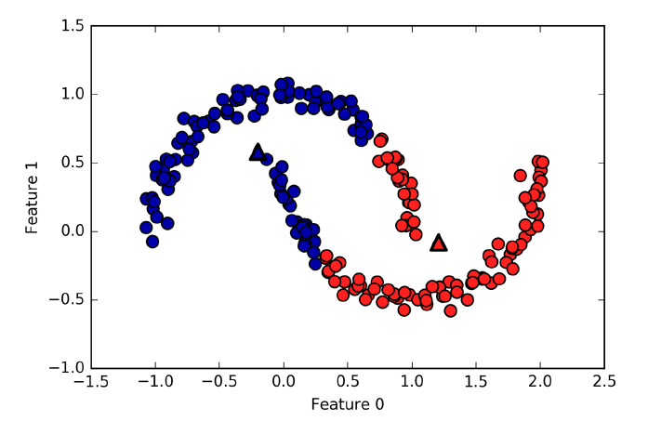
K-MEANS CLUSTERING - LIMITATIONS
Data Squad | Unsupervised Learning

Slide 15
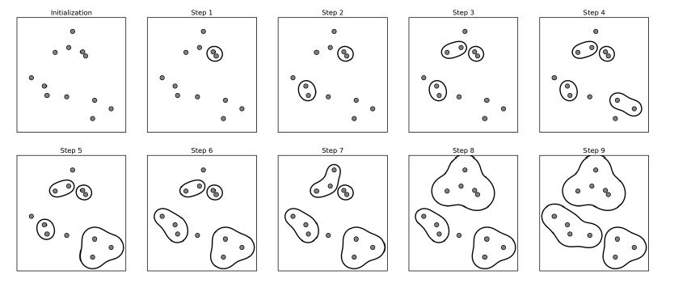
AGGLOMERATIVE CLUSTERING
Data Squad | Unsupervised Learning

Slide 16
AGGLOMERATIVE CLUSTERING
The algorithm starts by declaring each point as its own cluster
Then a criteria of merging between clusters is iteratively applied until the desired number of cluster is reached
There are several criteria of linkage that specify what are the two most similar clusters to merge
Data Squad | Unsupervised Learning

Slide 17
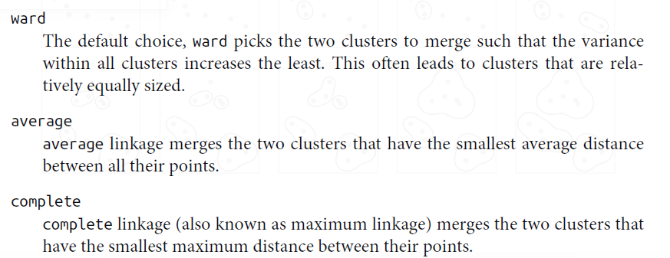
AGGLOMERATIVE CLUSTERING
There are several criteria of linkage that specify what are the two most similar clusters to merge
Data Squad | Unsupervised Learning

Slide 18
DBSCAN
Density Based Spatial Clustering of Applications with Noise
Does not require the user to set the number of clusters "a priori"
Is able to identify clusters of complex shapes and points that are not part of any cluster
Works by identifying regions that are "crowded" or of high density
As a consequence it looks for dense regions followed by relatively empty regions
Data Squad | Unsupervised Learning

Slide 19
DBSCAN
Requires two parameters:
eps: how close points should be to each other to be considered part of a cluster
minPoints: the minumum number of points to form a dense region. for example if equals to 5 then we need at least 5 points within a eps distance to be considered a cluster
Any values that do not satisfy the density requirements are considered as outliers.
Data Squad | Unsupervised Learning

Slide 20
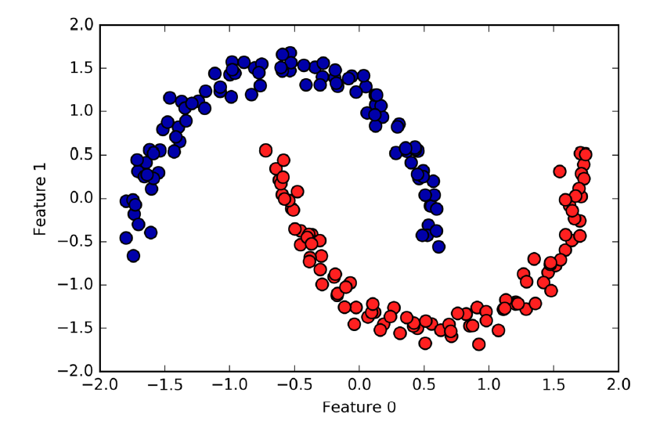
DBSCAN
Data Squad | Unsupervised Learning

Slide 21
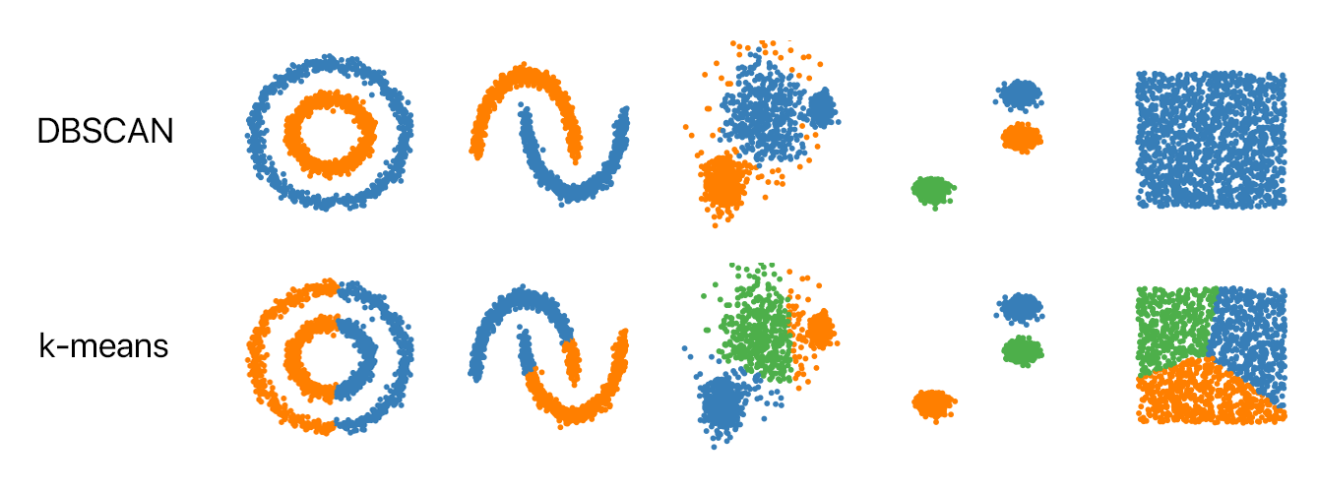
DBSCAN
Data Squad | Unsupervised Learning

Slide 22
EVALUATING UNSUPERVISED LEARNING
What are good clusters?
Data Squad | Unsupervised Learning

Slide 23
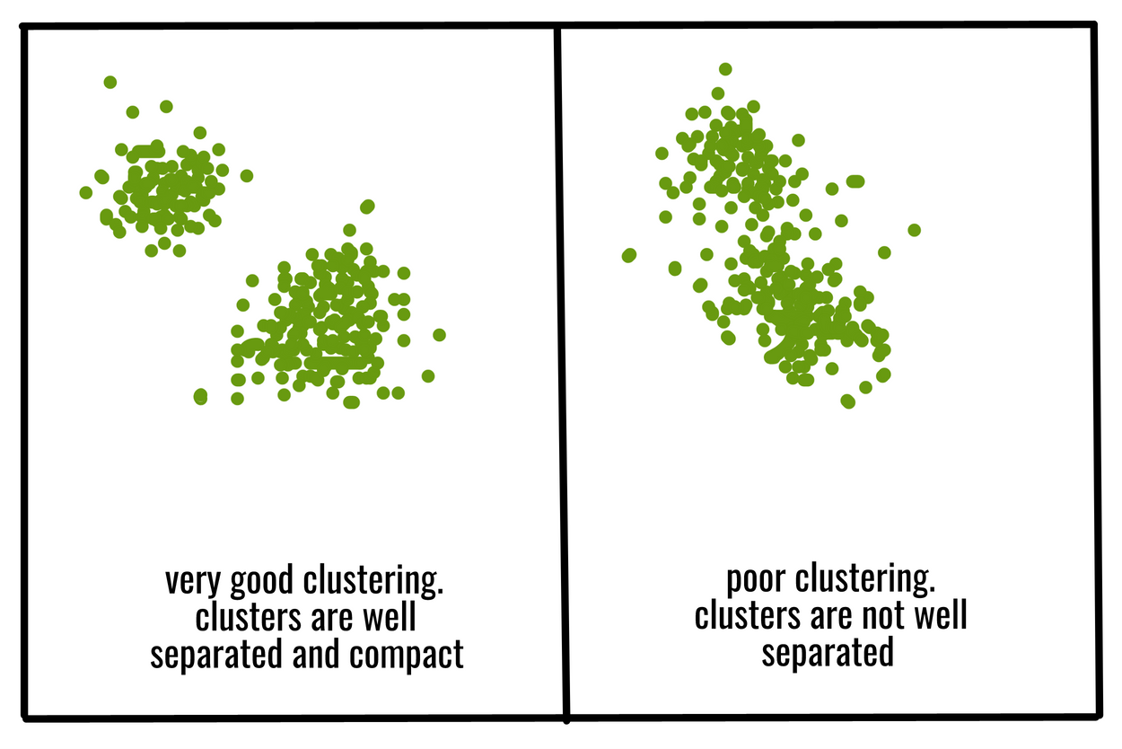
EVALUATING UNSUPERVISED LEARNING
What are good clusters?
Clusters have points tightly packed together
Clusters are far away from each other
Data Squad | Unsupervised Learning

Slide 24
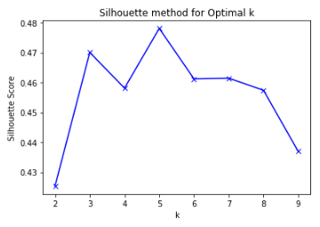
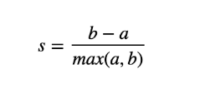
SILHOUETTE SCORE
a: mean distance between a sample point and all other points in the same cluster
b: mean distance between the sample and all other points on the nearest cluster
Data Squad | Unsupervised Learning

Slide 25
SILHOUETTE SCORE
separation
density
a: mean distance between a sample point and all other points in the same cluster
b: mean distance between the sample and all other points on the nearest cluster
Data Squad | Unsupervised Learning

Slide 26
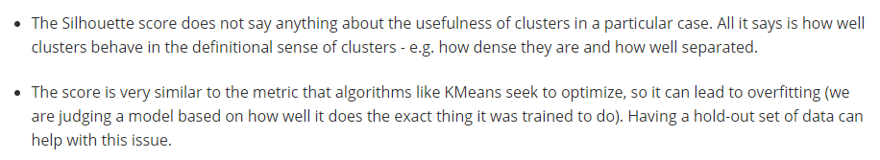
SILHOUETTE SCORE
Data Squad | Unsupervised Learning

Slide 27
SILHOUETTE SCORE
Data Squad | Unsupervised Learning

Slide 28
DIMENSIONALITY REDUCTION
Data Squad | Unsupervised Learning

Slide 29
DIMENSIONALITY REDUCTION
Allows us to convert a high dimensional problem into fewer features
Common Dimensionality Reduction Algorithms
(this we will see)
- Principal Component Analysis (PCA) - features concentrates variance
(these we will not)
- non-Negative Matrix Factorization (NMF) (features allow reconstruction of original dataset), SNEs (allows visualizing data as two-dimensional scatter plots), uMaping, etc
Data Squad | Unsupervised Learning

Slide 30
DIMENSIONALITY REDUCTION
Allows us to convert a high dimensional problem into fewer features
Is this the holy grail of feature engineering?
Well... it it is technically useful, reduces noise, improves score and reduces training time
But... it is certainly not interpretable and you often lose any realistic chance of of using domain level knowledge
Data Squad | Unsupervised Learning

Slide 31
PRINCIPAL COMPONENT ANALYSIS
If you could pick a single feature for learning, which one would you pick?
- the one with the most variance, since that is the most likely to carry discriminative information (e.g. salary vs free time/day)
What if you could pick a second one?
- the one with the second most variance.... but that may have an issue if it is too correlated with the first one (e.g. salary vs wealth)
So instead you pick the feature that captures the most variance except for the variance already captured in the first feature
PCA does this systematically
Data Squad | Unsupervised Learning

Slide 32
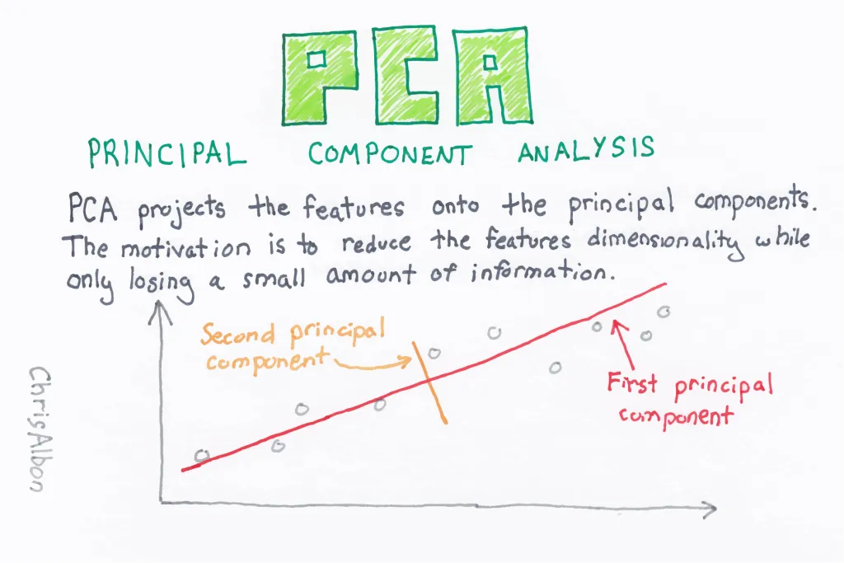
PRINCIPAL COMPONENT ANALYSIS
The PCA finds and combines the features which carry the most information into new "features"
The objective is to make the new features statistically uncorrelated so that each carries as much information as possible
Data Squad | Unsupervised Learning

Slide 33
PRINCIPAL COMPONENT ANALYSIS
And this is feature 2
Now this is feature1
Data Squad | Unsupervised Learning

Slide 34
ANY QUESTIONS ?

